Slide 1
Potentially Inappropriate Medications in Older Adults: Highlights from the 2015 American Geriatrics Society Updated Beers Criteria
Nada Abou-Karam, Pharm D, BCACP
June 21st, 2016

Slide 2
Objectives
Distinguish between appropriate and inappropriate prescribing, and discuss implications of inappropriate prescribing
Review the history and framework of the Beers Criteria
Highlight key differences between current and previous edition of Beers Criteria, including additions, deletions, and rationale modifications
Discuss the evidence behind select Beers Criteria recommendations
Discuss key principles for optimal application of Beers Criteria

Slide 3
Pre-Assessment
1. Prior to the October 2015 update, when was the Beers Criteria last updated, and by whom?
a. 2010, American Society of Consultant Pharmacists
b. 2012, American Geriatrics Society
c. 2003, American Geriatrics Society
d. 1991, Dr. Mark Beers

Slide 4
Pre-Assessment
2. The following changes appear in the 2015 Beers Criteria except:
a. New table on clinically important drug-drug interactions
b. New table on renal dosing
c. Addition of opioids to list of drugs to be avoided in patients with fall history
d. New recommendation to avoid “Z-drugs” (eszopliclone, zolpidem, zaleplon) for > 90 days

Slide 5
Pre-Assessment
3. According to the 2015 Beers Criteria, nitrofurantoin is best avoided in:
a. CrCl < 60 mL/min
b. CrCl < 30 mL/min
c. Long-term suppression of bacteria
d. B & C

Slide 6
Pre-Assessment
4. Proton pump inhibitors (PPIs) are listed in the 2015 Beers Criteria due to increased risk of:
a. Clostridium difficile infection
b. Bone loss
c. Fractures
d. All of the above

Slide 7
Appropriate vs. Inappropriate Prescribing
What is “appropriate”?
Clear evidence supports usage in a given condition AND
Clinical expected benefit outweighs risk of potential drug-induced harm
Consequences of inappropriate prescribing:
Physiological, psychological, financial
Impact patient, family/caregiver, providers, health systems, payors

Slide 8
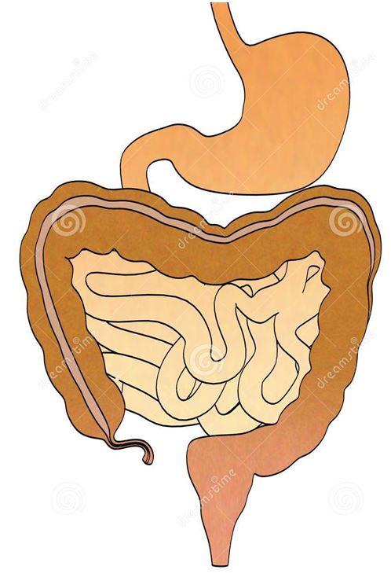
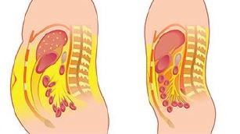
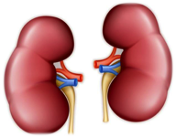
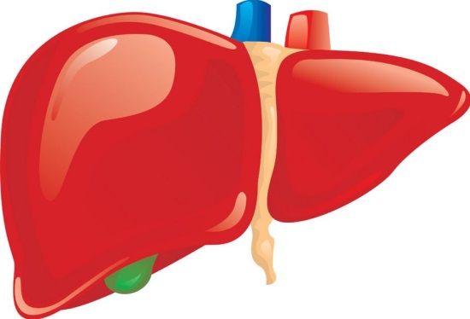
Older Adults and Adverse Drug Events
Elders are at high risk for adverse drug events (ADEs) given:
Age-related physiological changes
Greater degree of frailty
Greater number of coexisting conditions
Polypharmacy
http://img.medscapestatic.com/pi/features/slideshow-slide/obesity/fig10.jpg?resize=645:439,
https://www.google.com/search?q=muscles+and+fat

Slide 9
Older Adults and Drug-Related Hospitalization
ADEs requiring hospitalization are seven times more likely in older adults than younger persons¹
Utilization of Beers Criteria Potentially Inappropriate Medications (PIMs) in elderly individuals has been associated with increased risk of hospitalization²

Slide 10
Quality Measures Relating to PIMs
Approved Measurement Year 2016/Reporting Year 2017
Medicare Advantage Five-Star Reporting of Physician Organizations:
Measure #12: High Risk Medications
Measure #13: All-cause readmissions
California Value-based P4P Program:
Measure #42: All-cause readmissions
Measure #50: Emergency department visits

Slide 11
2015 Beers Criteria
Goal: “To improve care of older adults by reducing their exposure to PIMs”
Educational tool + quality measure
Not intended to be used punitively
Not a substitute for clinical judgment
Framework
Modified Delphi Criteria
Evidence and recommendation strength rankings
2015 aim: Incorporate new evidence since 2012 update
http://www.jhartfound.org/blog/wp-content/upLoads/2009/03/beerspic1-225x300.jpg

Slide 12
Overview of 2015 “Beers Lists”³
Table 2. | 2015 Beers Criteria for Potentially Inappropriate Medication Use in Older Adults
Table 3. | 2015 Beers Criteria for Potentially Inappropriate Medication Use in Older Adults DUE TO DRUG-DISEASE or DRUG-SYNDROME INTERACTIONS That May Exacerbate the Disease or Syndrome
Table 4. | 2015 Beers Criteria for Potentially Inappropriate Medications to be use with CAUTION in Older Adults
Table 5. | 2015 Beers Criteria for Potentially Clinically Important Non-Anti-infective DRUG-DRUG INTERACTIONS That Should Be Avoided in Older Adults
Table 6. | 2015 Beers Criteria for Non-Anti-infective Medications That Should be Avoided or Have Dosages Reduced with Varying Levels of KIDNEY FUNCTION in Older Adults
Table 7. | Drugs with Strong Anticholinergic Properties

Slide 13
Table 2 Changes: Nitrofurantoin^{3,4}
 | 2012 | 2015
Rationale | Potential for pulmonary toxicity; safer alternatives available; lack of efficacy in patients with CrCl < 60 mL/min due to inadequate drug concentration in urine | Potential for pulmonary toxicity, hepatoxicity, and peripheral neuropathy, especially with long-term use; safer alternatives available
Recommendation | Avoid for long-term suppression; avoid in patients with CrCl < 60 mL/min | Avoid in individuals with CrCl <30 mL/min or for long-term suppression of bacteria

Slide 14
Table 2 Changes: Dronedarone^{3,4}
 | 2012 | 2015
Rationale | Worse outcomes have been reported in patients who have permanent atrial fibrillation or heart failure. In general, rate control is preferred over rhythm control for atrial fibrillation | Worse outcomes have been reported in patients who have permanent atrial fibrillation or severe or recently decompensated heart failure
Recommendation | Avoid in patients with permanent atrial fibrillation or heart failure | Avoid in individuals with permanent atrial fibrillation or severe or recently decompensated heart failure

Slide 15
Table 2 Changes: Digoxin^{3,4}
 | 2012 | 2015
Rationale | > 0.125 mg/d: In heart failure, higher dosages associated with no additional benefit and may increase risk of toxicity; slow renal clearance may lead to risk of toxic effects | Atrial fibrillation: should not be used first-line; more-effective alternatives exist, and may be associated with increased mortality Heart failure: questionable effects on risk of hospitalization and may be associated with increased mortality in older adults with heart failure; in heart failure, higher dosages not associated with additional benefit and may increase risk of toxicity
Recommendation | Avoid > 0.125 mg/d | Avoid as first-line therapy for atrial fibrillation and heart failure

Slide 16
Table 2 Changes: Nonbenzodiazepine, Benzodiazepine Receptor Agonist Hypnotics^{3,4}
 | 2012 | 2015
Rationale | Have adverse events similar to those of benzodiazepines in older adults (e.g., delirium, falls, fractures); minimal improvement in sleep latency and duration | Have adverse events similar to those of benzodiazepines in older adults (e.g., delirium, falls, fractures); increased emergency department visits and hospitalizations; motor vehicle crashes; minimal improvement in sleep latency and duration
Recommendation | Avoid chronic use (> 90 days) | Avoid

Slide 17
Table 2 Changes: Antipsychotics^{3,4}
 | 2012 | 2015
Rationale | Increased risk of stroke and mortality in persons with dementia | Increased risk of stroke and greater rate of cognitive decline and mortality in persons with dementia. Avoid for behavioral problems of dementia or delirium unless nonpharmacological options (e.g., behavioral interventions) have failed or are not possible AND the older adult is threatening substantial harm to self or others
Recommendation | Avoid use for behavioral problems of dementia Unless nonpharmacological options have failed and patient is threat to self or others | Avoid, except for schizophrenia, bipolar disorder, or short-term use as antiemetic during chemotherapy

Slide 18
Table 2: Additions and Removals³
Additions:
Proton-pump inhibitors
Desmopressin
Anticholinergics, first generation antihistamines - meclizine
Removals:
Antiarrhythmic drugs (Class 1a, 1c, III except amiodarone) as first line for atrial fibrillation
Trimethobenzamide
Mesoridazine
Chloral hydrate

Slide 19
Table 2 Addition: Proton-Pump Inhibitors³
2015 Rationale | 2015 Recommendation
Risk of Clostridium difficile infection and bone loss and fractures | Avoid scheduled use for >8 weeks unless for high-risk patients (e.g., oral corticosteroids or chronic NSAID use), erosive esophagitis, Barrett’s esophagitis, pathological hypersecretory condition, OR demonstrated need for maintenance treatment (e.g., due to failure of drug discontinuation trial or H2 blockers)

Slide 20
Table 3 Addition: Opioids³
Added to list of medications to be avoided in history of falls or fractures
Excludes pain management due to recent fractures or joint replacement
“If one of the drugs must be used, consider reducing use of other CNS-active medications that increase risk of falls and fractures (i.e., anticonvulsants, opioid receptor agonists, antipsychotics, antidepressants, benzodiazepine receptor agonists, other sedatives and hypnotics) and implement other strategies to reduce fall risk”

Slide 21
Key Principles for Optimal Use of Beers Criteria⁵
Key Principles to Guide Optimal Use of the AGS 2015 Beers Criteria
1. Medications in the Beers Criteria are potentially inappropriate, not definitely inappropriate.
2. Read the rationale and recommendations statements for each criterion. Caveats and guidance listed are important.
3. Understand why medications are included in the Beers Criteria and adjust approach to those medications accordingly.
4. Optimal application of Beers Criteria involves identifying PIMs and where appropriate offering safer nonpharmacological and pharmacological therapies.
5. AGS 2015 Beers Criteria should be a starting point for a comprehensive process of identifying and improving medication appropriateness and safety.
6. Access to medications in the Beers Criteria should not be excessively restricted by prior authorization and/or health plan policies.
7. AGS 2015 Beers Criteria are not equally applicable to all countries.

Slide 22
Application for Clinicians⁵
“Warning light” approach
If prescribed: ongoing monitoring, periodic attempts to discontinue or reduce doses
Careful inquiry into adverse effects
Can be subtle yet important, ex: small changes in balance/gait stability
Broaden medication review beyond Beers Criteria
Engage patients, colleagues in discussion and explore alternatives
Taper as appropriate vs. sudden discontinuation
Educate and involve nurses and other professionals

Slide 23
Application for Health-Systems and Payors⁵
Clinical decision support systems
Suggest alternative pharmacological and nonpharmacological therapies
Performance measurement across large groups of patients and providers is reasonable
Should not be used to judge care for individual patients
Target rate should not be 0%
Flagging of Beers medications reasonable in health plan design
Criteria should not be sole standard for coverage determination or prior authorization
Streamlined process to justify use

Slide 24
Patient ZP
Patient ZP
65 yof w/ PMH long-standing head and neck CA
AMS on arrival
Recent discharge from Sharp Grossmont Rehab for opiate dependency
Found down on stair landing, unconscious
CT→ massive subarachnoid hemorrhage, intraventricular hemorrhage, and cerebral contusions w/ evidence of effacement
Comfort Cares Day 2, declared deceased Day 6

Slide 25
Patient ZP
Further history:
Per patient’s son:
Believes that patient took zolpidem few hours prior to fall
Had been taking zolpidem for “several months”
Note from rehab discharge:
Zolpidem not listed as discharge medication
No previous record of zolpidem in EMR despite multiple recent readmissions and clinic visits
Could this fall have been prevented?

Slide 26
Summary
The 2015 AGS Beers Criteria has several important updates, including:
Addition of new medications
Clarification of 2012 criteria language
Addition of select drugs for which dose adjustment is required based on kidney function
Addition of select drug-drug interactions
Beers Criteria medications are potentially inappropriate in older adults, and may be appropriate in select patients or circumstances
Pharmacists are well-educated and often well-positioned to apply Beers Criteria thoughtfully, and should collaborate with physicians and other health professionals to decrease adverse drug events in older adults

Slide 27
Post-Assessment
1. Prior to the October 2015 update, when was the Beers Criteria last updated, and by whom?
a. 2010, American Society of Consultant Pharmacists
b. 2012, American Geriatrics Society
c. 2003, American Geriatrics Society
d. 1991, Dr. Mark Beers

Slide 28
Post-Assessment
2. The following changes appear in the 2015 Beers Criteria except:
a. New table on clinically important drug-drug interactions
b. New table on renal dosing
c. Addition of opioids to list of drugs to be avoided in patients with fall history
d. New recommendation to avoid “Z-drugs” (eszopliclone, zolpidem, zaleplon) for > 90 days

Slide 29
Post-Assessment
3. According to the 2015 Beers Criteria, nitrofurantoin is best avoided in:
a. CrCl < 60 mL/min
b. CrCl < 30 mL/min
c. Long-term suppression of bacteria
d. B & C

Slide 30
Post-Assessment
4. Proton pump inhibitors (PPIs) are listed in the 2015 Beers Criteria due to increased risk of:
a. Clostridium difficile infection
b. Bone loss
c. Fractures
d. All of the above

Slide 31
References
Budnitz, Daniel S, et al. "National surveillance of emergency department visits for outpatient adverse drug events." JAMA: the Journal of the American Medical Association 296.15 (2006):1858-66.
Price, Sylvie D, et al. "Impact of specific Beers Criteria medications on associations between drug exposure and unplanned hospitalisation in elderly patients taking high-risk drugs: a case-time-control study in Western Australia." Drugs & aging 31.4 (2014):311-25.
Fick DM, Semla TP, Beizer J, Brandt N, Dombrowski R, DuBeau CE, Eisenberg W, Epplin JJ, Flanagan N, Giovannetti E, Hanlon J, Hollmann P, Laird R, Linnebur S, Sandhu S, Steinman M. American Geriatrics Society 2015 updated beers criteria for potentially inappropriate medication use in older adults. J Am Geriatr Soc. 2015;63(11):2227–46.
Campanelli CM. American Geriatrics Society Updated Beers Criteria for Potentially Inappropriate Medication Use in Older Adults: The American Geriatrics Society 2012 Beers Criteria Update Expert Panel. Journal of the American Geriatrics Society. 2012;60(4):61.
M.A. Steinman, J.L. Beizer, C.E. DuBeau, et al. How to use the American Geriatrics Society 2015 Beers Criteria-a guide for patients, clinicians, health systems, and payors. J Am Geriatr Soc, 63 (2015), pp. e1–e7.

Slide 32
Questions?

